Slide 1

Modern Programming Tools And Techniques-I Lecture 14: Exception Handling
Lovely Professional University, Punjab

Slide 2
Exception

Slide 3
Introduction
An exception is an event, which occurs during the execution of a program, that disrupts the normal flow of the program's instructions.
A Java exception is an object that describes an exceptional (that is, error) condition that has occurred in a piece of code.
An exception is an abnormal condition that arises in a code sequence at run time.
In other words, an exception is a run-time error.

Slide 4
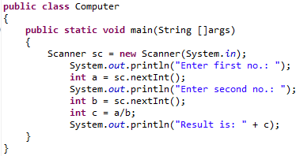
Exception Handling

Slide 5
Exception Handling
An Exception is a run-time error that can be handled programmatically in the application and does not result in abnormal program termination.
Exception handling is a mechanism that facilitates programmatic handling of run-time errors.
In java, each run-time error is represented by an object.

Slide 6
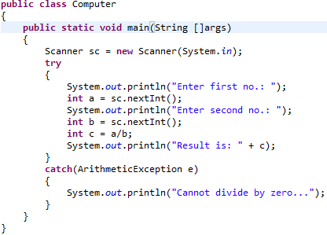
Modified example

Slide 7
Exception (Class Hierarchy)
At the root of the class hierarchy, there is an abstract class named ‘Throwable’ which represents the basic features of run-time errors.
There are two non-abstract sub-classes of Throwable.
Exception : can be handled
Error : can’t be handled
RuntimeException is the sub-class of Exception.
Exceptions of this type are automatically defined for the programs that we write and include things such as division by zero and invalid array indexing.
Each exception is a run-time error but all run-time errors are not exceptions.

Slide 8
Throwable
Exception Error
Run-time Exception - VirtualMachine
IOEXception - ArithmeticException - NoSuchMethod
SQLException - ArrayIndexOutOf - StackOverFlow
BoundsException
- NullPointerException
Checked Exception
Unchecked Exception

Slide 9
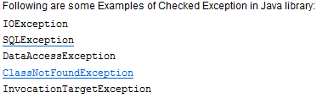
Checked Exception
Checked Exceptions are those, that have to be either caught or declared to be thrown in the method in which they are raised.
It is a reminder by compiler to programmer to handle failure senarios.
When to use:
Operation where chances of failure are more eg: IO operation, database access, networking operation, etc.

Slide 10

Unchecked Exception
Those exceptions whose handling is not verified during compile-time.
It is direct sub-class of RuntimeException.
Advantage: maintains code readability.
They arise due to:
Programming errors (like accessing method of null object, accessing element outside array)

Slide 11
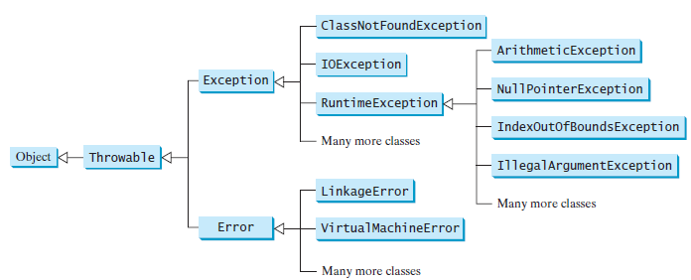
Hierarchy of exception classes
Un-checked exceptions

Slide 12
Commonly used sub-classes of Exception
ArithmeticException
ArrayIndexOutOfBoundsException
NumberFormatException
NullPointerException
IOException

Slide 13
Commonly used sub-classes of Errors
VirtualMachineError
StackOverFlowError
NoClassDefFoundError
NoSuchMethodError

Slide 14
Uncaught Exceptions
class Exception_Demo
{
public static void main(String args[])
{
int d = 0;
int a = 42 / d;
}
}
When the Java run-time system detects the attempt to divide by zero, it constructs a new exception object and then throws this exception.
once an exception has been thrown, it must be caught by an exception handler and dealt with immediately.

Slide 15
In the previous example, we haven’t supplied any exception handlers of our own.
So the exception is caught by the default handler provided by the Java run-time system.
Any exception that is not caught by your program will ultimately be processed by the default handler.
The default handler displays a string describing the exception, prints a stack trace from the point at which the exception occurred, and terminates the program.
java.lang.ArithmeticException: / by zero at Exc0.main(Exc0.java:4)

Slide 16
Why Exception Handling?
When the default exception handler is provided by the Java run-time system , why Exception Handling?
Exception Handling is needed because:
it allows to fix the error, customize the message .
it prevents the program from automatically terminating

Slide 17
Exception Handling

Slide 18
Keywords for Exception Handling
try
catch
throw
throws
finally

Slide 19
Keywords for Exception Handling
try
used to execute the statements whose execution may result in an exception.
try {
Statements whose execution may cause an exception
}
Note: try block is always used either with catch or finally or with both.

Slide 20
Keywords for Exception Handling
catch
catch is used to define a handler.
It contains statements that are to be executed when the exception represented by the catch block is generated.
If program executes normally, then the statements of catch block will not executed.
If no catch block is found in program, exception is caught by JVM and program is terminated.

Slide 21
class Divide{
public static void main(String arr[]){
try {
int a= Integer.parseInt(arr[0]);
int b= Integer.parseInt(arr[1]);
int c = a/b;
System.out.println(“Result is: ”+c);
}
catch (ArithmeticException e)
{System.out.println(“Second number must be non-zero”);}
catch (NumberFormatException n)
{System.out.println(“Arguments must be Numeric”);}
catch (ArrayIndexOutOfBoundsException a)
{System.out.println(“Invalid Number of arguments”);}
}
}

Slide 22
Nested Try’s
class NestedTryDemo {
public static void main(String args[]){
try {
int a = Integer.parseInt(args[0]);
try {
int b = Integer.parseInt(args[1]);
System.out.println(a/b);
}
catch (ArithmeticException e)
{
System.out.println(“Div by zero error!");
}
}
catch (ArrayIndexOutOfBoundsException) {
System.out.println(“Need 2 parameters!");
}
}}

Slide 23
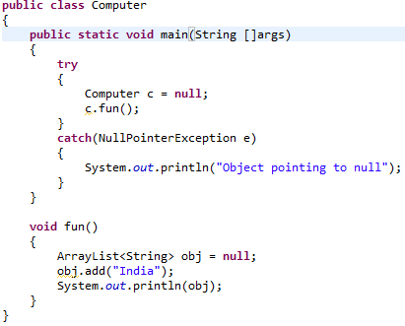
Exception thrown by called function

Slide 24
Defining Generalized Exception Handler
A generalized exception handler is one that can handle the exceptions of all types.
If a class has a generalized as well as specific exception handler, then the generalized exception handler must be the last one.

Slide 25
class Divide{
public static void main(String arr[]){
try {
int a= Integer.parseInt(arr[0]);
int b= Integer.parseInt(arr[1]);
int c = a/b;
System.out.println(“Result is: ”+c);
}
catch (Throwable e)
{
System.out.println(e);
}
}
}

Slide 26
Keywords for Exception Handling
throw
used for explicit exception throwing.
throw(Exception obj);
‘throw’ keyword can be used:
to throw user defined exception
to customize the message to be displayed by predefined exceptions
to re-throw a caught exception
Note: System-generated exceptions are automatically thrown by the Java run-time system.

Slide 27
class ThrowDemo
{
static void demo()
{
try {
throw new NullPointerException("demo");
}
catch(NullPointerException e)
{
System.out.println("Caught inside demo.");
throw e; // rethrow the exception
}
}
public static void main(String args[])
{
try {
demo();
}
catch(NullPointerException e)
{
System.out.println("Recaught: " + e);
}
}
}

Slide 28
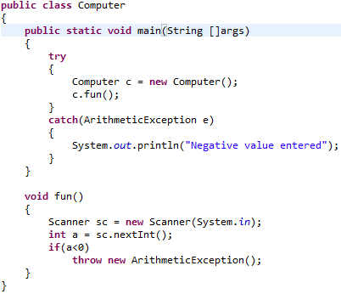
Example

Slide 29
Keywords for Exception Handling
throws
A throws clause lists the types of exceptions that a method might throw.
type method-name(parameter-list) throws exception-list
{
// body of method
}
This is necessary for all exceptions, except those of type Error or Runtime Exception, or any of their subclasses.
All other exceptions that a method can throw must be declared in the throws clause. If they are not, a compile-time error will result.

Slide 30
import java.io.*;
public class ThrowsDemo
{
public static void main( String args []) throws IOException {
char i;
BufferedReader br = new BufferedReader(new InputStreamReader(System.in));
System.out.println("Enter character, 'q' to quit");
do{
i = (char) br.read();
System.out.print(i);
}while(i!='q');
}
}

Slide 31
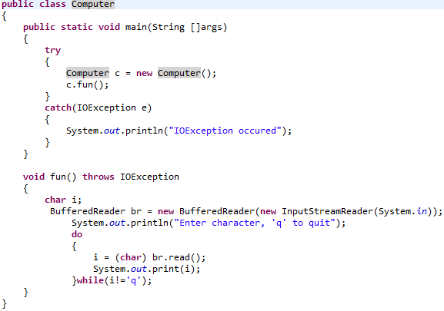
Example of “throws” keyword

Slide 32
Keywords for Exception Handling
Finally
finally creates a block of code that will be executed after a try/catch block has completed and before the code following the try/catch block.
The finally block will execute whether or not an exception is thrown.
If an exception is thrown, the finally block will execute even if no catch statement matches the exception.

Slide 33
If a finally block is associated with a try, the finally block will be executed upon conclusion of the try.
The finally clause is optional. However, each try statement requires at least one catch or a finally clause.

Slide 34
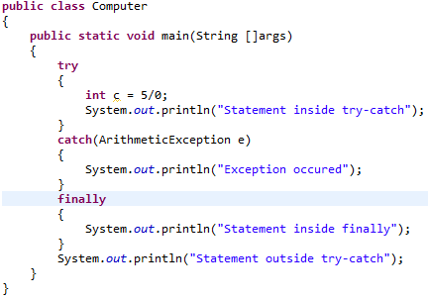
Example

Slide 35
Defining Custom Exceptions
We can create our own Exception sub-classes by inheriting Exception class.
The Exception class does not define any methods of its own.
It inherits those methods provided by Throwable.
Thus, all exceptions, including those that we create, have the methods defined by Throwable available to them.

Slide 36
Constructor for creating Exception
Exception( )
Exception(String msg)
A custom exception class is represented by a subclass of Exception / Throwable.
It contains the above mentioned constructor to initialize custom exception object.

Slide 37
class Myexception extends Throwable
{
public Myexception(int i)
{
System.out.println("you have entered ." +i +" : It exceeding the limit");
}
}

Slide 38
public class ExceptionTest {
public void show(int i) throws Myexception
{
if(i>100)
throw new Myexception(i);
else
System.out.println(+i+" is less then 100 it is ok");
}
public static void main(String []args){
int i=Integer.parseInt(args[0]);
int j=Integer.parseInt(args[1]);
ExceptionTest t=new ExceptionTest();
try{
t.show(i); t.show(j);
}
catch(Throwable e) {
System.out.println("catched exception is "+e);
}
}
}
Here object of custom class is created and thrown

Slide 39
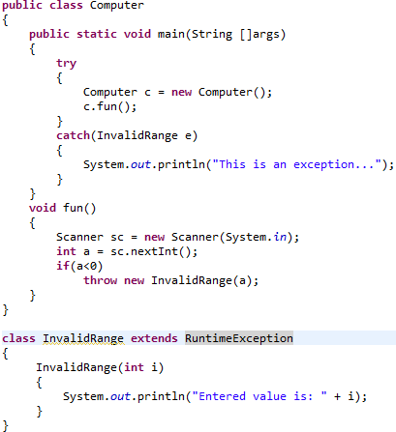
Custom/ user-defined exception

Slide 40


